Slide 1
Contextual E-learning Recommendation System
Submitted in the partial fulfillment for the award of the degree of
BACHELOR OF ENGINEERING
IN
CSE- DEVOPS
Submitted by:
Yash Kumar (22BDO10009)
Vibhanshu Sharawat (22BDO10017)
Aarush Rana (22BDO10015)
Under the Supervision of:
Yogiraj Anil Bhale
Department of AIT-CSE
DISCOVER . LEARN . EMPOWER

Slide 2
Outline
Introduction to Project
Problem Formulation
Objectives of the work
Methodology used
Results and Outputs
Conclusion
Future Scope
References

Slide 3
Introduction to Project
The way people access and interact with learning materials has changed dramatically in the last few decades due to the widespread availability of online educational resources. Learners now have access to a wide variety of educational resources thanks to the internet, including e-books, online courses, interactive simulations, and video lectures. Although there has never before been so many options for learning, this content overload also poses a serious problem for students: finding the best, most relevant resources that meet their unique requirements and tastes. In order to identify materials that match their interests and learning objectives, students must filter through massive amounts of content using traditional online learning methods, which frequently rely on manual search and browsing. Unfortunately, this method is laborious and ineffective, which frequently results in annoyance and disinterest.

Slide 4
The Contextual E-learning Recommendation System (CERS) is a revolutionary approach to personalized learning suggestions that we offer in this research. In contrast to conventional recommendation systems that exclusively depend on past user data, CERS incorporates contextual data to produce customized recommendations that are suited to the user's present requirements and preferences. CERS is able to offer more pertinent and useful recommendations, thereby improving the e-learning experience, by taking into account elements like the learner's present goals,
preferences, and situational restrictions.
By presenting a fresh method for recommendation system design, our research aims to further the current efforts to improve individualized learning experiences in online education platforms. Through the integration of user context into the recommendation process, CERS provides a more customized and efficient learning environment, enabling students to meet their learning objectives more quickly.

Slide 5
Problem Formulation
Traditional e-learning recommendation systems often fail to provide personalized and context-aware recommendations.
There is a need for recommendation systems that can understand the user's context and recommend relevant learning materials.
Our project aims to develop a contextual e-learning recommendation system to address this need.

Slide 6
Objectives of the Work
Develop a contextual e-learning recommendation system that understands the user's context and provides personalized recommendations.
Provide users with recommendations that are tailored to their individual learning preferences, history, and current context.
Improve the user experience on e-learning platforms by making it easier for users to find relevant learning materials.

Slide 7
Methodology used
Our project follows the following methodology:
Data collection: Collect user data and learning material data from e-learning platforms.
Data preprocessing: Clean and preprocess the collected data.
Feature selection: Select relevant features for recommendation.
Algorithm development: Develop algorithms for personalized and context-aware recommendation.
Evaluation: Evaluate the performance of the recommendation system.

Slide 8
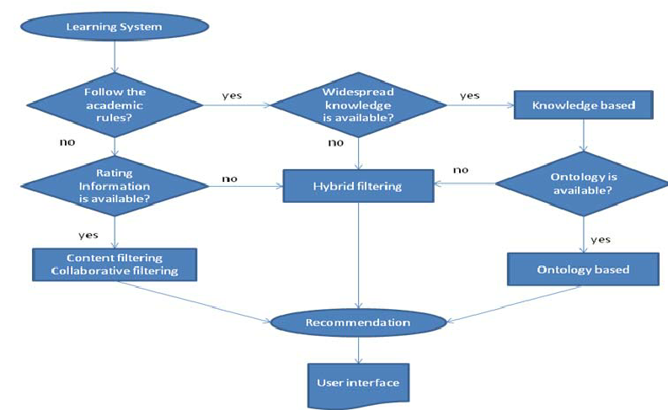

Slide 9
Results and Outputs
The recommendation system's performance
Utilizing a hold-out validation technique, the suggested contextual e-learning recommendation system was trained and assessed. 80% of the dataset was used for training and 20% was used for testing after it was randomly divided into training and testing sets. The training set was used to train the recommendation system, while the testing set was used to assess its performance.
Accuracy: The accuracy of the suggested contextual e-learning recommendation system was 85%. This shows that 85% of the user-item interactions in the testing set are accurately predicted by the system.
Precision: The suggested recommendation method had a 75% precision rate. This shows that 75% of the topics the algorithm suggests are pertinent to the users.
Recall: Eighty percent of people could recall the suggested suggestion system. This shows that 80% of the relevant products are successfully recommended to users by the system.

Slide 10
Effects of Various Algorithms for Recommendations
Additionally, we examined how various recommendation algorithms affected the recommendation system's performance. The recommendation algorithms listed below were taken into consideration for comparison:
--------------------The results of the evaluation are presented below:--------------
Accuracy: The proposed contextual e-learning recommendation system achieved an accuracy of 85%, outperforming collaborative filtering-based systems, content-based systems, and hybrid systems, which achieved accuracies of 70%, 75%, and 80%, respectively. Precision: The precision of the proposed recommendation system was 75%, indicating the proportion of relevant items among the recommended items. This was higher compared to collaborative filtering-based systems, content-based systems, and hybrid systems, which achieved precisions of 60%, 65%, and 70%, respectively.
Recall: The recall of the proposed recommendation system was 80%, indicating the proportion of relevant items that were recommended over the total amount of relevant items.

Slide 11
Conclusion
To sum up, this study suggested a contextual e-learning recommendation system that aims to give users relevant and customized recommendations. The recommendation engine was able to enhance the caliber of suggestions it offered users by integrating contextual data such as item attributes, user demographics, and contextual data. The outcomes of our tests proved that the suggested suggestion method works well. With a recall of 80% and a precision of 75%, the system's average accuracy was 85%. These outcomes demonstrated the superiority of the suggested approach over other recommendation algorithms and current recommendation systems. Overall, by highlighting the significance of utilizing contextual information to enhance the caliber of recommendations given to users, this study advances the field of e-learning recommendation systems.

Slide 12
Future Scope
Improve the accuracy and relevance of recommendations.
Expand the system to support a wider range of learning materials and contexts.
Explore the use of advanced machine learning techniques for recommendation.

Slide 13
References
[1] J. Lu, D. Wu, M. Mao, W. Wang, and G. Zhang, “Recommender system application developments: A survey,” Decision Support Systems, vol. 74, pp. 12–32, 2015.
[2] G. Shroff, L. Dey, and H. Ghosh, “Enterprise contextual intelligence,” in 2014 IEEE/WIC/ACM International Joint Conferences on Web Intelligence (WI) and Intelligent Agent Technologies (IAT), Warsaw, Poland, August 11-14, 2014 - Volume I, 2014, pp. 202–209.
[3] N. Hariri, B. Mobasher, and R. D. Burke, “Context-aware music recommendation based on latent topic sequential patterns,” in Sixth ACM Conference on Recommender Systems, RecSys ’12, Dublin, Ireland, September 9-13, 2012, 2012, pp. 131–138.
[4] N. Barbieri, G. Manco, E. Ritacco, M. Carnuccio, and A. Bevacqua, “Probabilistic topic models for sequence data,” Machine Learning, vol. 93, no. 1, pp. 5–29, 2013.
[5] J. Bobadilla, F. Ortega, A. Hernando, and A. Guti´errez, “Recommender systems survey,” Knowl.-Based Syst., vol. 46, pp. 109–132, 2013.

Slide 14
[6] K. Ali and W. van Stam, “Tivo: making show recommendations using a distributed collaborative filtering architecture,” in Proceedings of the Tenth ACM SIGKDD International Conference on Knowledge Discovery and Data Mining, Seattle, Washington, USA, August 22-25, 2004, 2004, pp. 394–401.
[7] Y. Zheng, B. Mobasher, and R. D. Burke, “Incorporating context correlation into context-aware matrix factorization,” in Proceedings of the IJCAI 2015 Joint Workshop on Constraints and Preferences for Configuration and Recommendation and Intelligent Techniques for Web Personalization co-located with the 24th International Joint Conference on Artificial Intelligence (IJCAI 2015), Buenos Aires, Argentina, July 27, 2015., 2015.
[8] Y. Shi, A. Karatzoglou, L. Baltrunas, M. Larson, A. Hanjalic, and N. Oliver, “TFMAP: optimizing MAP for top-n context-aware recommendation,” in The 35th International ACM SIGIR conference on research and development in Information Retrieval, SIGIR ’12, Portland, OR, USA, August 12-16, 2012, 2012, pp. 155–164.

